Slide 1


AtliQ Hardware’s
Consumer Goods
Ad_Hoc Insights
SONIYA YADAV

Slide 2
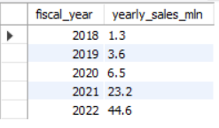
Yearly report for ‘croma’ customer
Question
Generate a yearly report for ‘croma’ customer where the output contains these
fields :
fiscal_year
yearly_gross_sales
make sure that yearly_gross_sales are in millions
Output
SONIYA YADAV

Slide 3
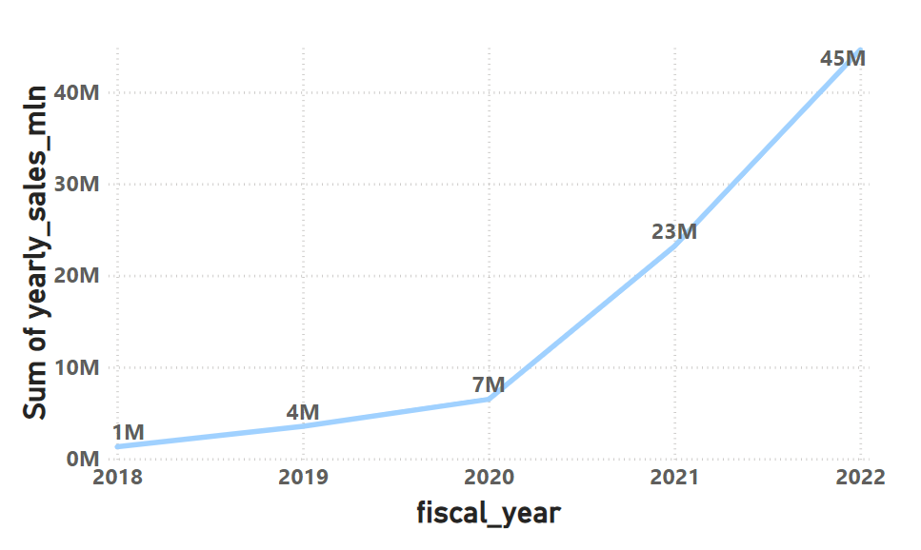
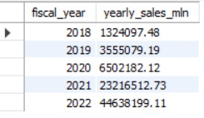
Conversion of output to visual
Insights
Croma’s gross sales are steadily growing at a rate of over 200-300% annually
Strategic decisions are positively impacting revenue generation for that customer.
So Croma is considered as valuable customer.
SONIYA YADAV

Slide 4
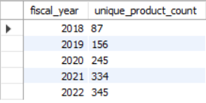
Yearly Product growth Analysis
Question
Generate a report which contains the fiscal year and also the number of unique products sold in that year. This helps AtliQ Hardware’s regarding the development of new products and its growth year on year
Output
SONIYA YADAV

Slide 5
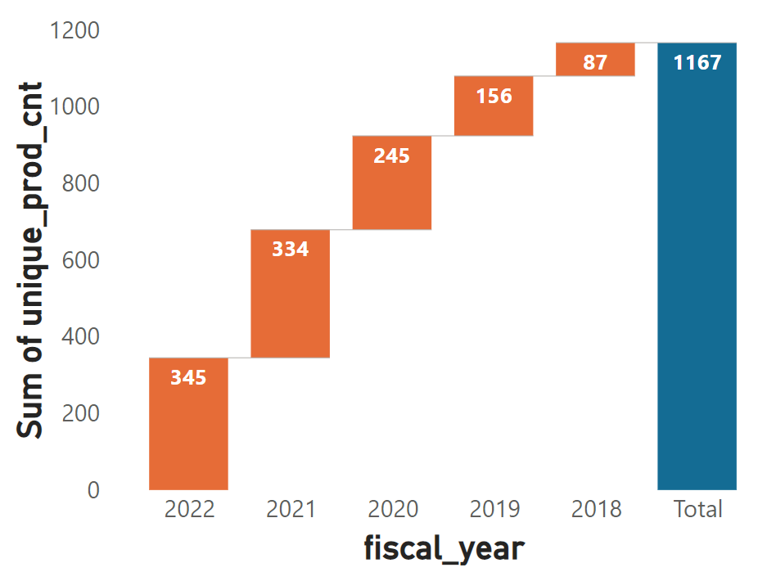
Conversion of output to visual
Insights
Results indicate AtliQ Hardware's are competitive by introducing new products.
AtliQ Hardware’s are focused on increasing revenue by improving product strengths and creating in-demand products.
SONIYA YADAV

Slide 6
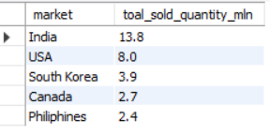
Total sold quantity by ‘market’ FY 2021
Question
Get top 5 markets by their total quantity sold for fiscal_year ‘2021’ where the output contains these fields :
market
total sold_quantity in millions
Output
SONIYA YADAV

Slide 7
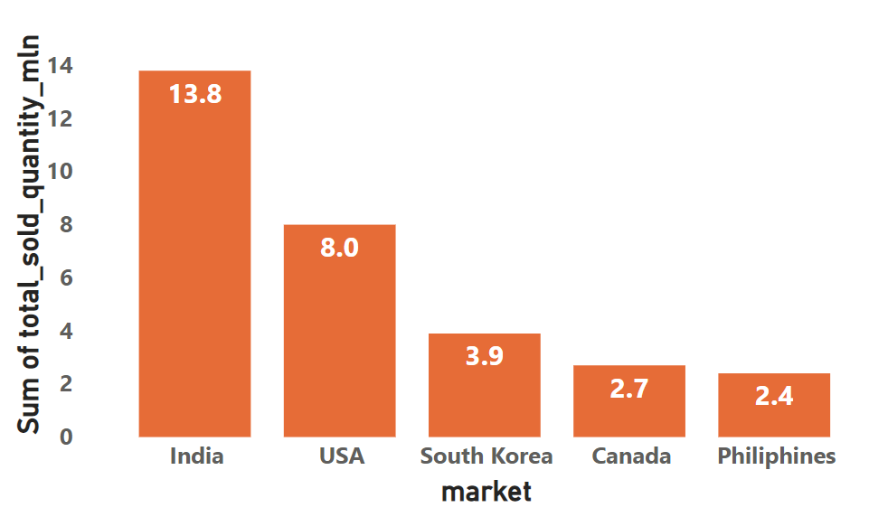
Conversion of output to visual
Top 5 market’s by total quantity sold FY 21
Insights
India is the clear leader in terms of quantity sold with 13.8 M units, which is significantly higher than the next closest country, the USA, with 8 M units sold.
The top 5 markets, India, USA, South Korea, Canada, Philippines accounts for more than 25 % of the total quantity sold.
The lowest quantity sold in countries such as Mexico, Sweden, Brazil, Chile and Columbia suggests that they may not have a significant presence in the market.
SONIYA YADAV

Slide 8
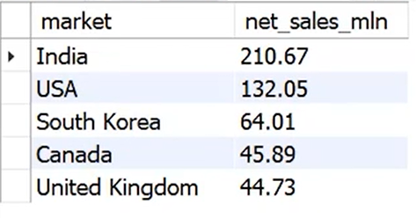
FY 2021 Market–wise Net Sales Report
Question
Generate FY 2021 net sales report for top markets where the output contains these fields :
market
net sales
make sure that net sales are in millions
Output
SONIYA YADAV

Slide 9
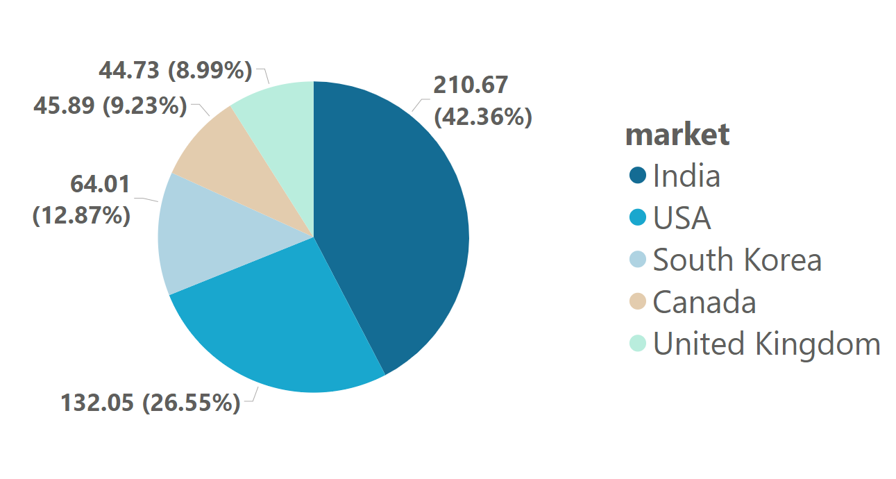
Conversion of output to visual
Top 5 market’s by net_sales FY 21
Insights
The country with the highest net sales is India, which has a value of 210.6 million. Following closely behind is the United States, with net sales of 132.05 million.
To clarify, the market’s with net sales <10 million include Bangladesh, Poland, Pakistan, Austria, Sweden, Mexico, Brazil, Chile, and Columbia. For business operating in these market’s, it may be beneficial to focus on strategies such as improving customer satisfaction, increasing online presence, and offering promotions and discounts, similar to what successful businesses in other markets are doing.
SONIYA YADAV

Slide 10
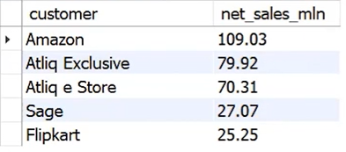
FY 2021 Customer–wise Net Sales Report
Question
Generate FY 2021 net sales report for top customer where the output contains these fields :
customer
net sales
make sure that net sales are in millions
Output
SONIYA YADAV

Slide 11
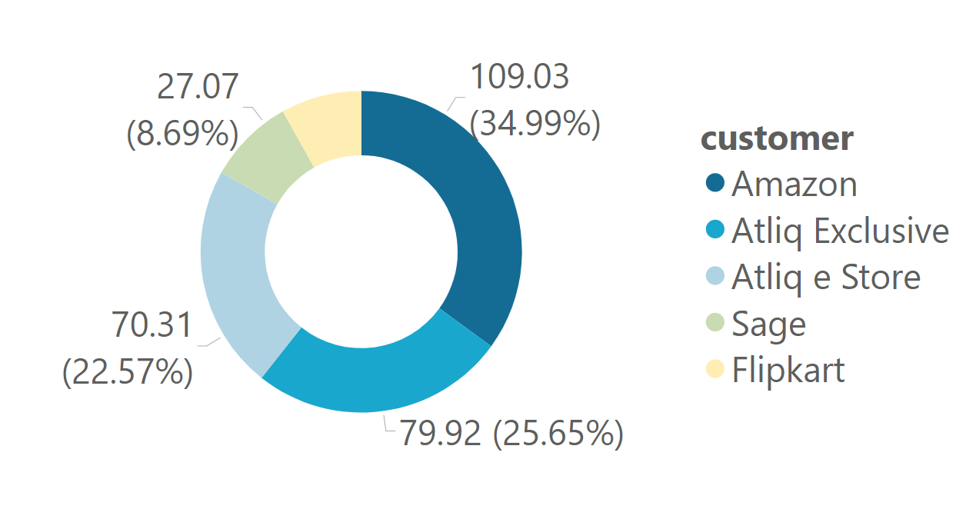
Conversion of output to visual
Top 5 customer’s based on net sales for FY 21
Insights
Amazon with the highest net sales for FY 2021, which has a value of 109.03 million. Following AtliQ Exclusive, with net sales of 79.92 million and AtliQ e Store with net sales 70.31 million
AtliQ’s net sales contribution to the overall customer’s net sales percentage is 22.3 %, indicating that AtliQ accounts for a significant portion of the total net sales.
SONIYA YADAV

Slide 12
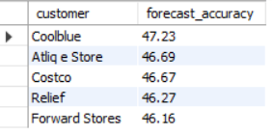
Forecast Accuracy Report for FY 2021
Question
Get forecast accuracy report at the customer_code level for FY 21 where the output contains these fields :
customer
forecast accuracy
Output
Top 5 customer’s listed have fairly similar forecast accuracy percentages, ranging from 47.23 % - 46.16 %. This suggests that these customer’s are likely using similar forecasting methods.
SONIYA YADAV

